Slide 1

SQL COMMANDS

Slide 2
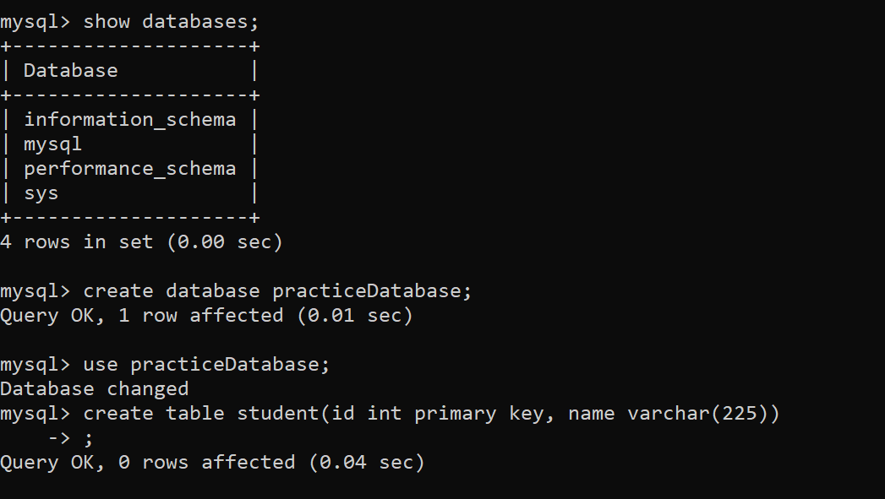

Slide 3
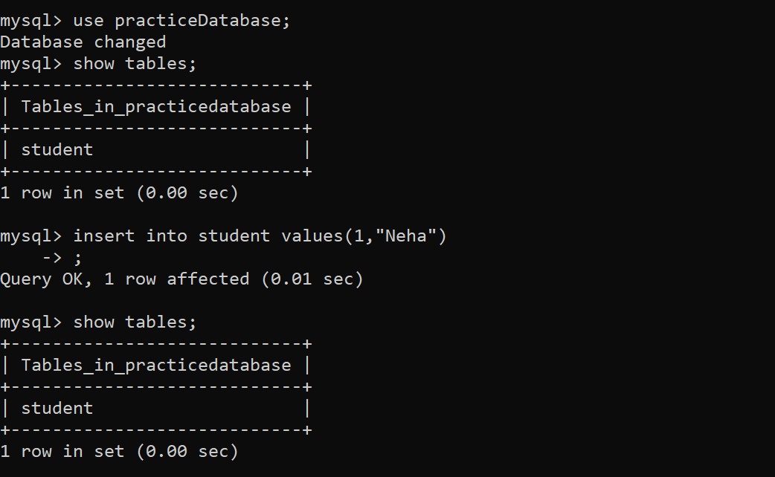

Slide 4
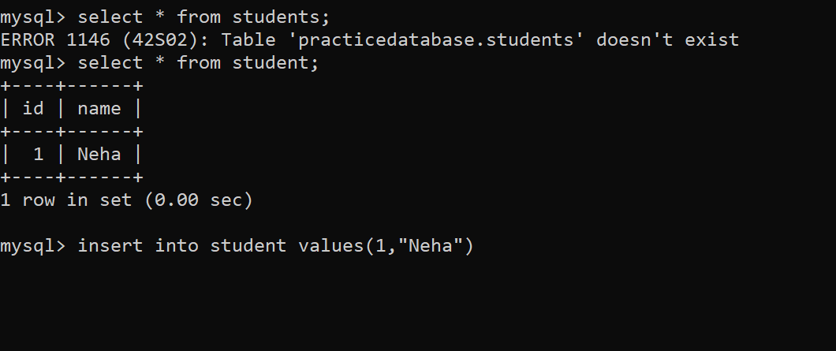
The columns in a table are called fields while the rows can be referred to as records.

Slide 5
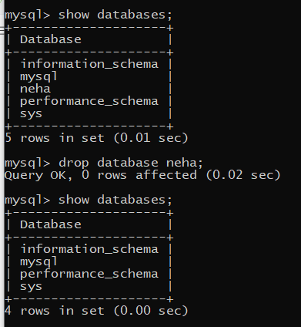

Slide 6
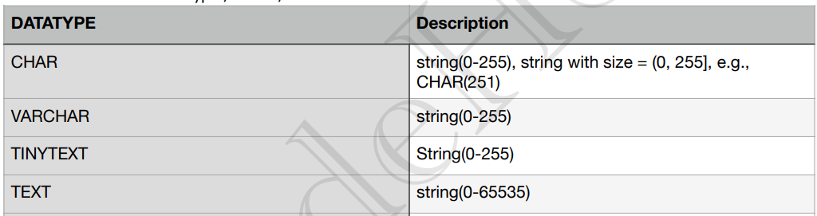
Data type: to store data in which form
Char : fixed size eg: array in java of fixed size
Varchar : variable size eg: arrayList in java (according to need :space efficient approach)
Text : similar to varchar but with more space .

Slide 7
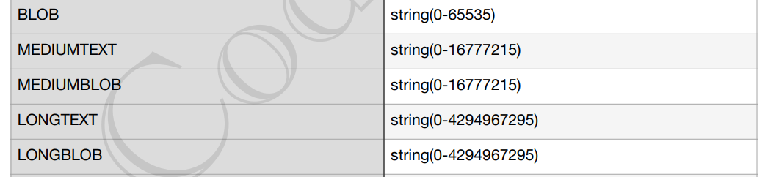
Any type of file being stored in bits format is the most efficient way of storing data if we don’t have any cloud service for storing data.
BLOB : bulky file

Slide 8
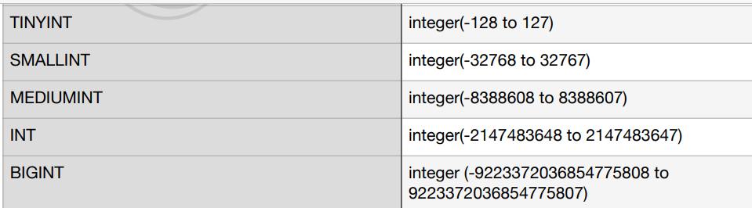
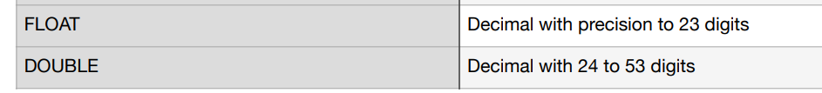
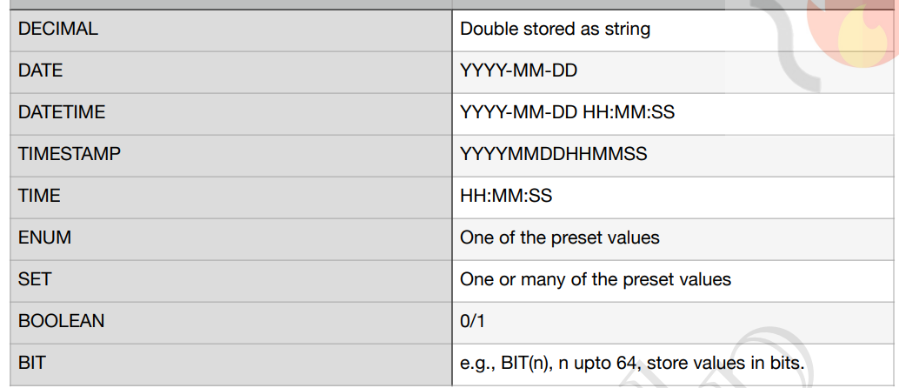

Slide 9
A set of values
Enum : one value at a time
Set : set of values can be assigned at a time .
**Values can also be unsigned e.g., INT UNSIGNED.
JSON : key value pair of data . As a object

Slide 10
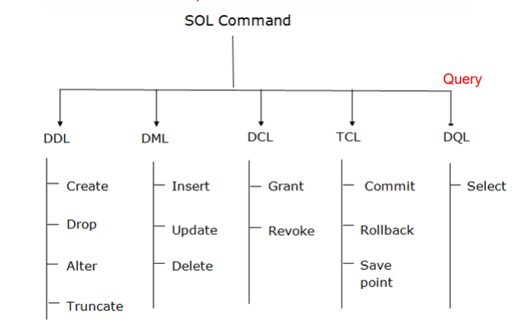
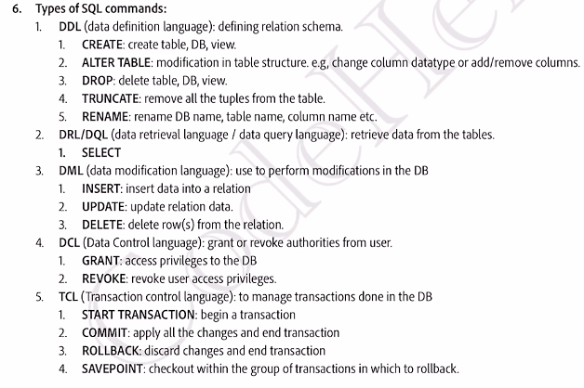

Slide 11
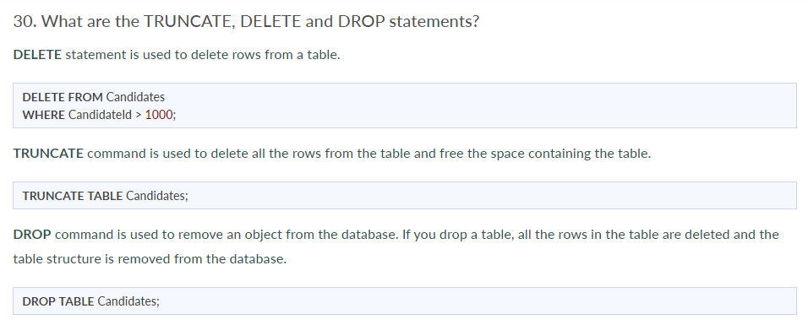

Slide 12
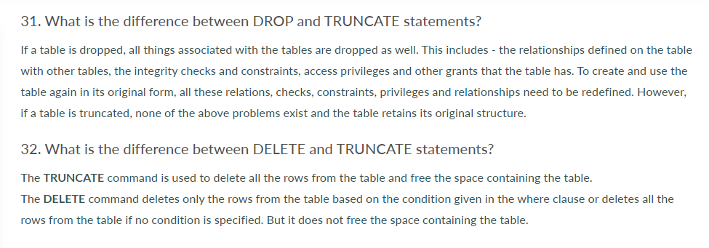

Slide 13
Transaction
Set of actions/task
performed to access and modify the contents of the database as per the user’s request.

Slide 14
Q.4: What is meant by schedules of transactions in DBMS?
When multiple transaction requests are made at the same time, we need to decide the order of execution of these transactions.
This chronological order of execution of transactions is called as a schedule of transactions in DBMS.
It is mainly of two types, i.e. Serial Schedules and Non Serial Schedules.

Slide 15
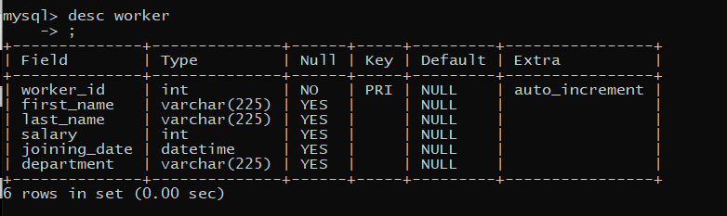
create table worker(worker_id int primary key auto_increment , first_name varchar(225),last_name varchar(225), salary int , joining_date datetime , department varchar(225))

Slide 16
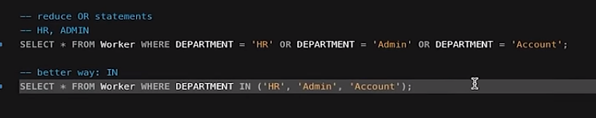
Logical operator :
AND
OR
NOT

Slide 17
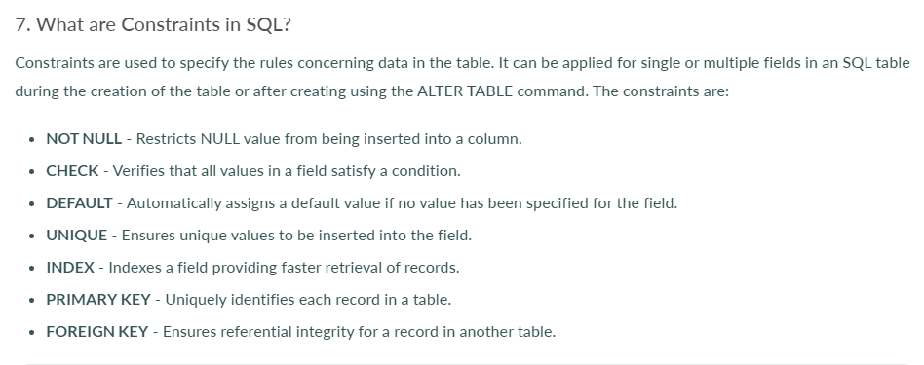

Slide 18
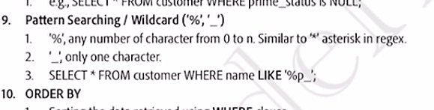
REGEX

Slide 20
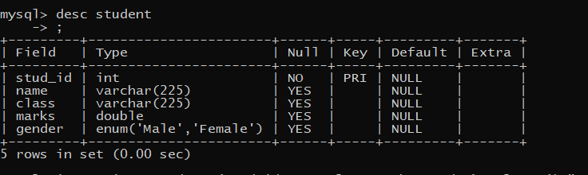
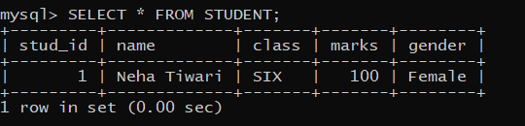
create table student (stud_id int primary key , name varchar(225),class varchar(225),marks double , gender enum ('Male','Female') );
insert into student (stud_id,name,class,marks,gender) values (1,"Neha Tiwari","SIX",100,"FEMALE");
** NOTE : MYSQL is not case sensitive

Slide 21
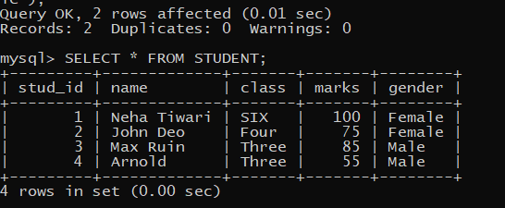
Insert query remains same for one insertion of data or multiple
Eg :
insert into student (stud_id,name,class,marks,gender) values (2, 'John Deo', 'Four', 75, 'female');
insert into student (stud_id,name,class,marks,gender) values (3, 'Max Ruin', 'Three', 85, 'male'),(4,'Arnold', 'Three', 55, 'male');

Slide 22
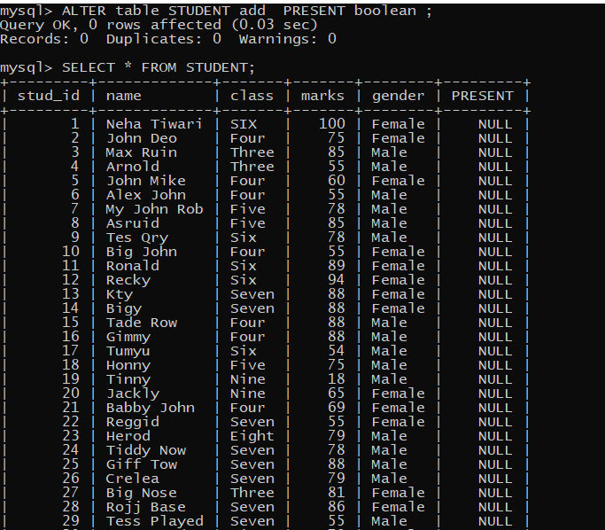
ALTER TABLE STUDENT ADD PRESENT BOOLEAN ;

Slide 23
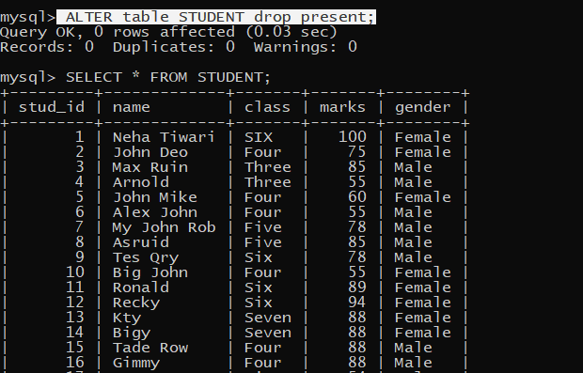

Slide 24
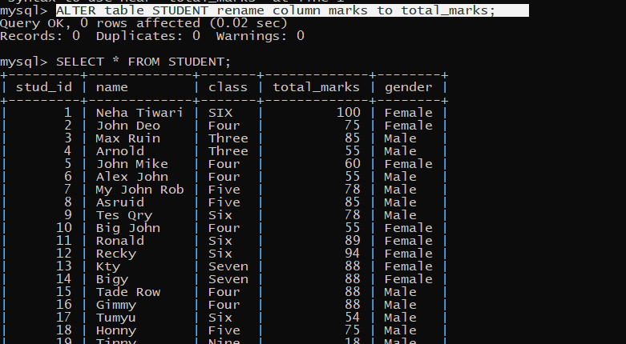

Slide 25
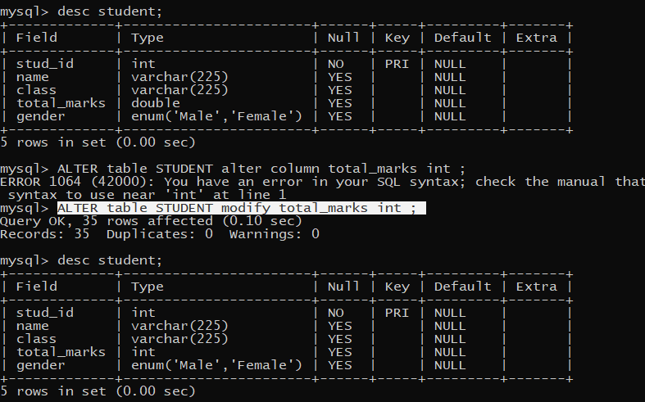

Slide 26
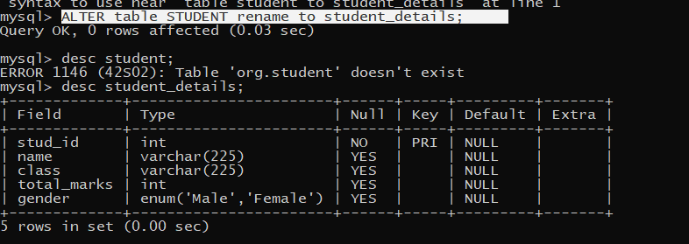

Slide 27
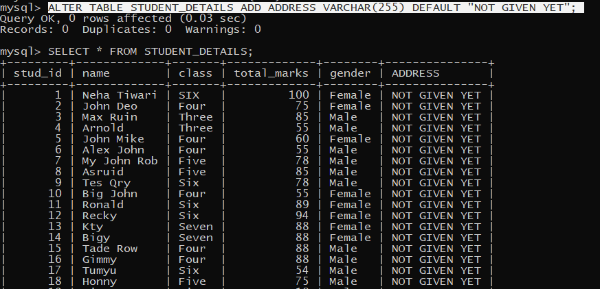

Slide 28
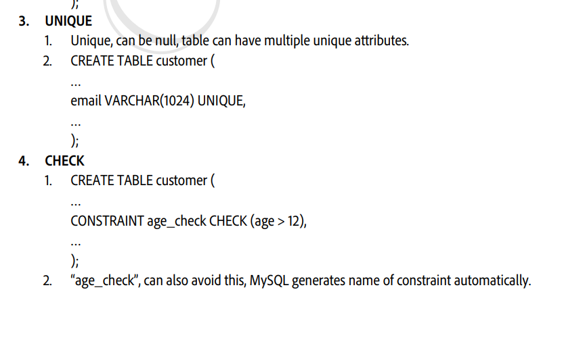
VALIDATION

Slide 29
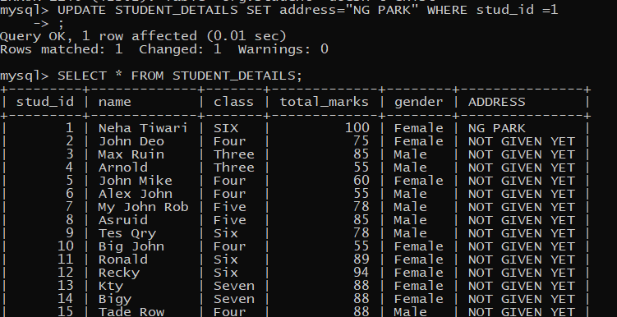

Slide 30
DELETE FROM STUDENT_DETAILS WHERE STUD_ID IN (34,35);
Query OK, 2 rows affected (0.01 sec)

Slide 31
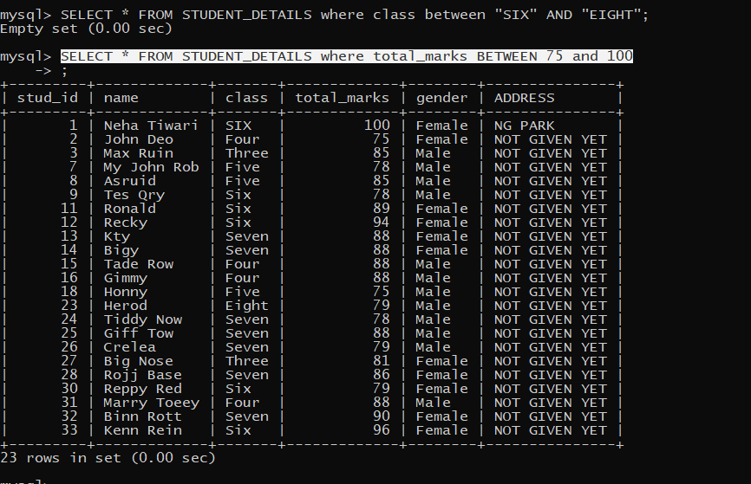
BETWEEN : ONLY WITH NUMBERS AND INCLUSIVE IN NUMBERS;

Slide 32
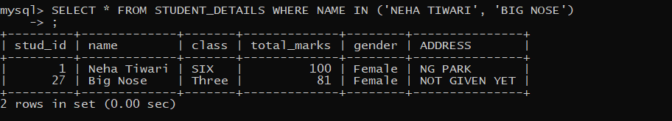
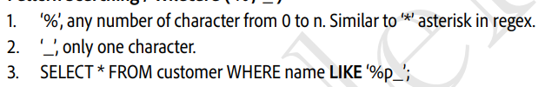
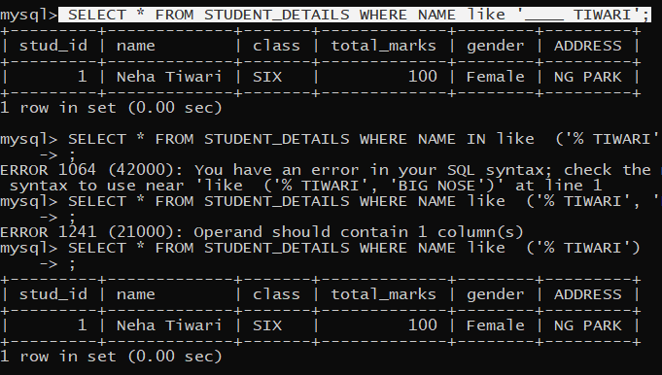
IN : to provide a list of data to filter it out from the whole table (OR gate internally)
LIKE

Slide 33
ORDER BY : FOR SORTING (applicable for all columns )
(2 mode : ASC AND DESC)
SELECT * FROM STUDENT_DETAILS ORDER BY CLASS ASC;

